Slide 1
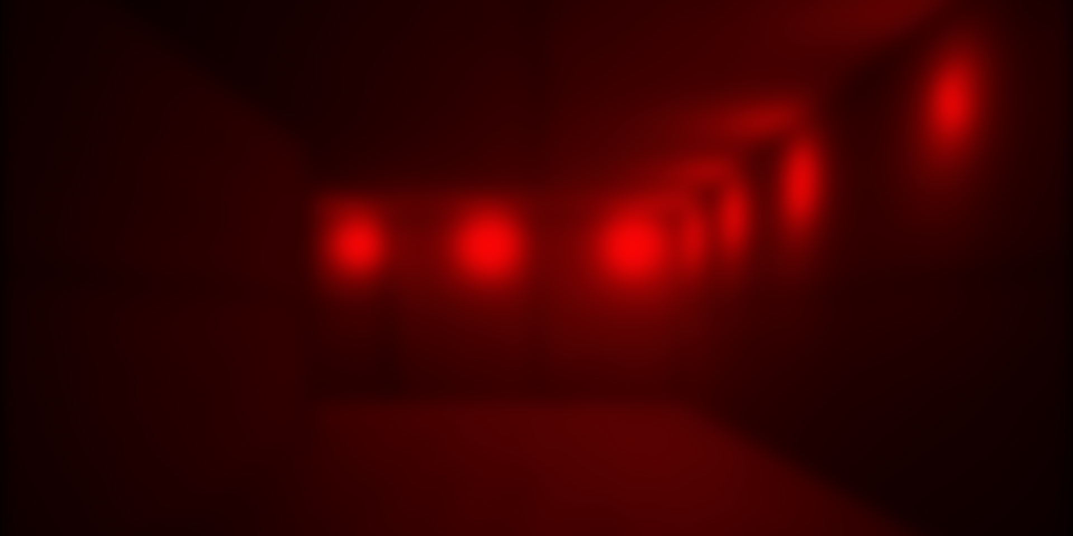

Eden‘s Dawn
By Tobi

Slide 2
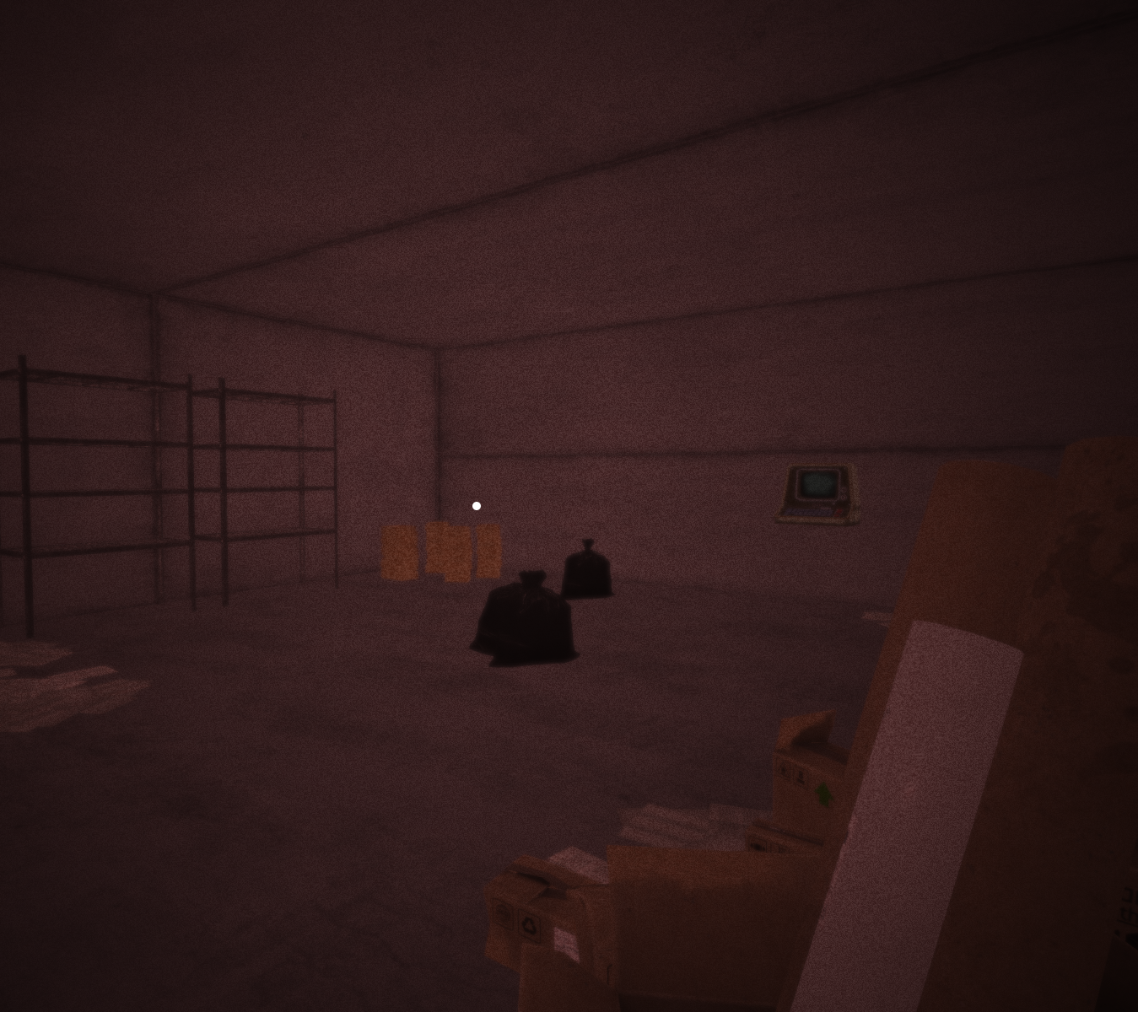
The Idea
In a dystopian future, humanity hides underground to escape a toxic world. In Eden’s Dawn, you play a nameless character trying to reach the surface—sneaking through abandoned halls, dodging surveillance, uncovering secrets.
Goal: Escape unseen and witness the first sunrise in generations.

Slide 3
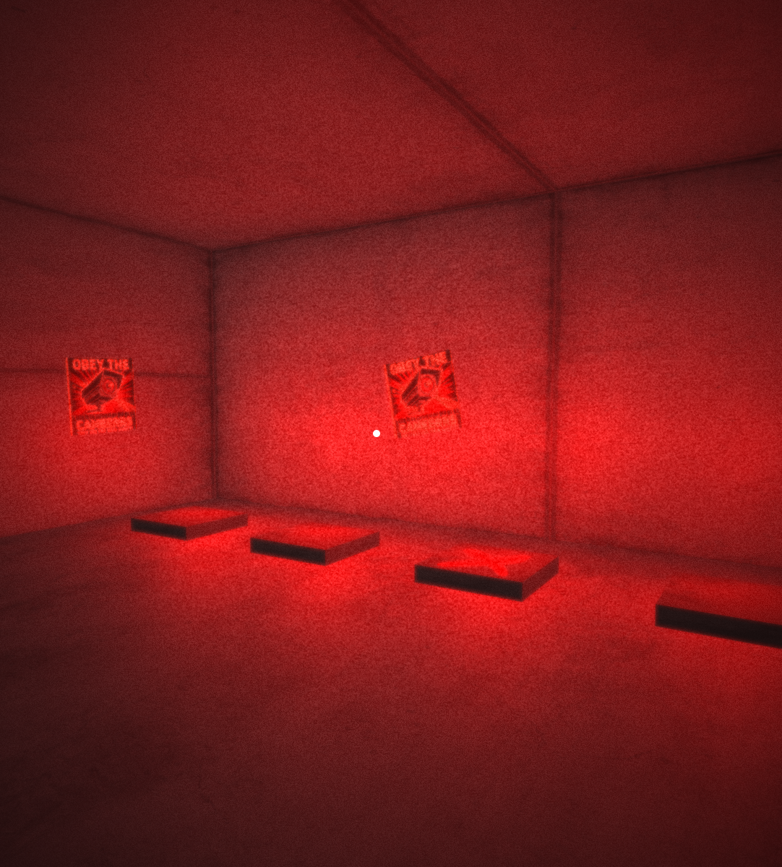
Highlights
Border logic
Json for structure

Slide 4
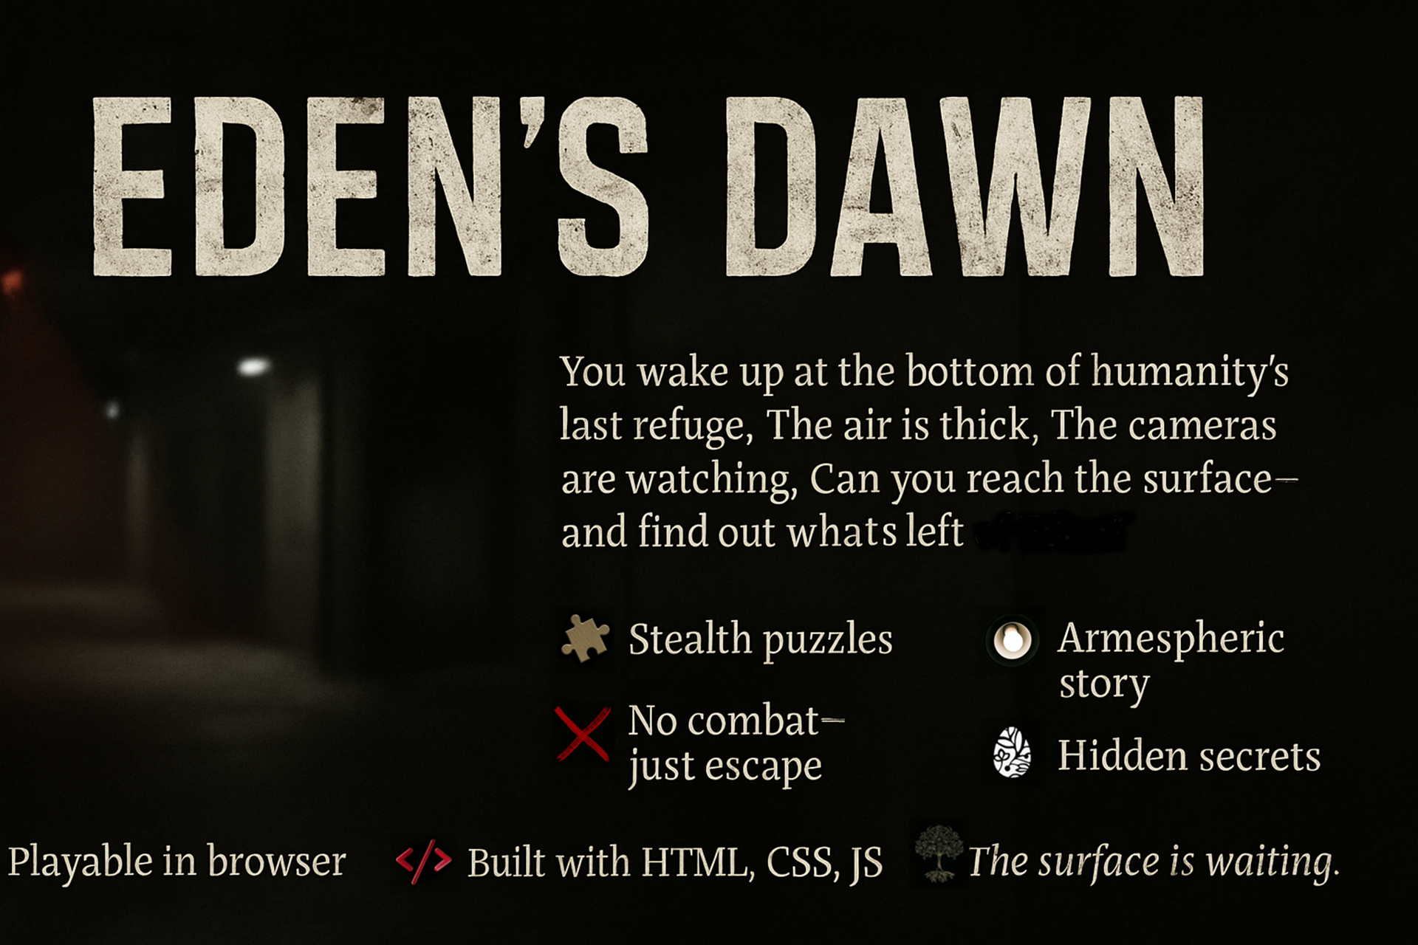

Slide 5
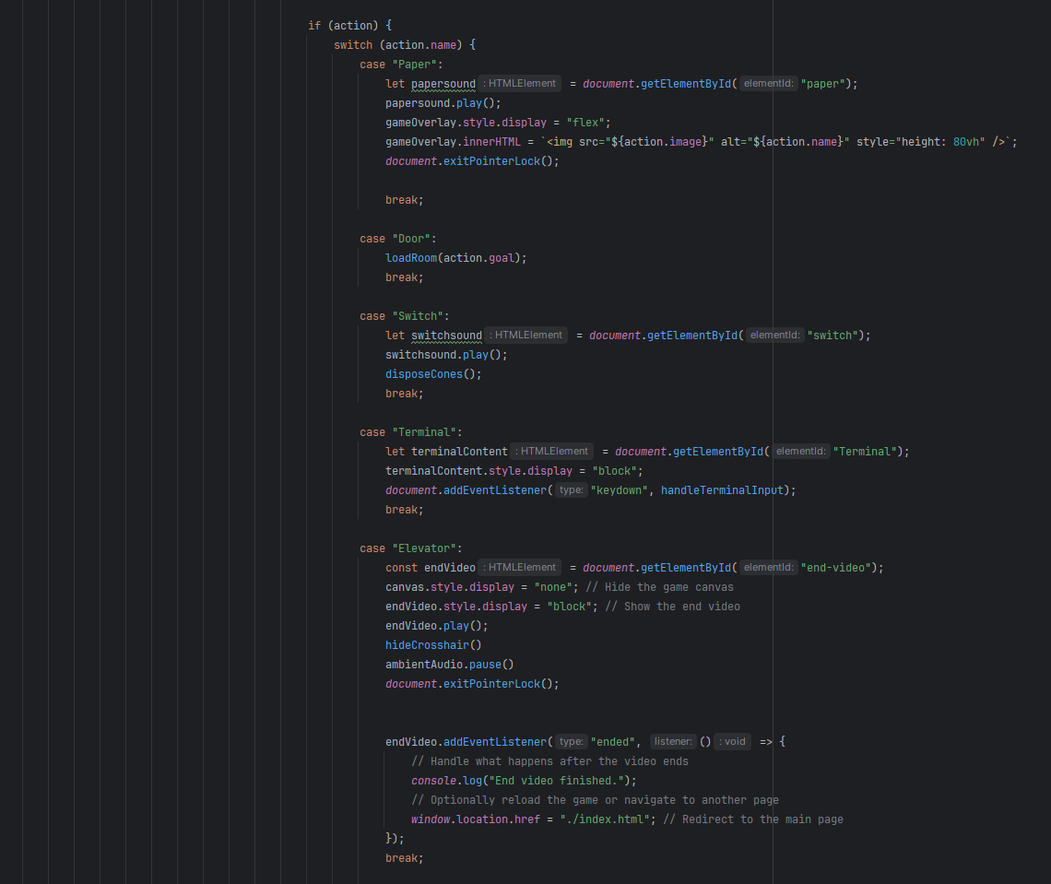
Wichtige Codefragmente
Action Handeling

Slide 6
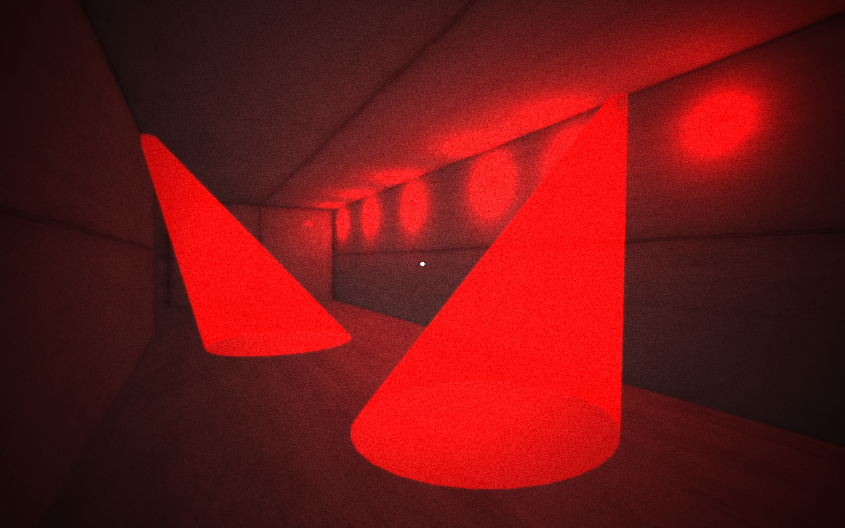
Live Demo

